Slide 1

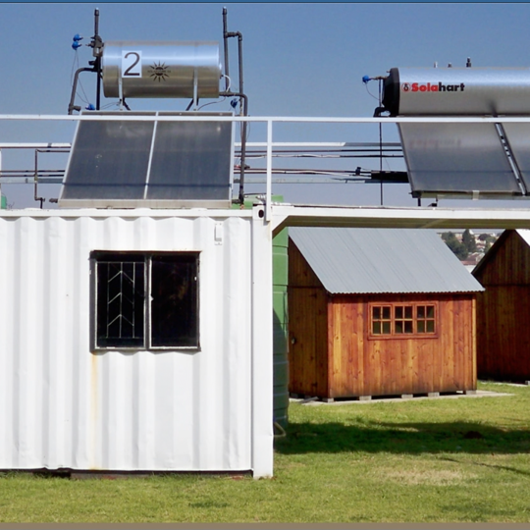
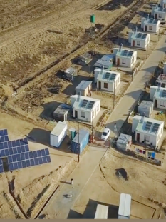
  Eskom Demand Side Management
  How can it sustainably be implemented for the benefit of the economy?
Malcolm Van Harte
Senior Manager - SMART GRID & TELECOM
NECOM co-chair Workstream 5
October 2023, Rev03

Slide 2


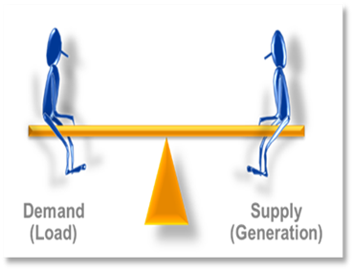
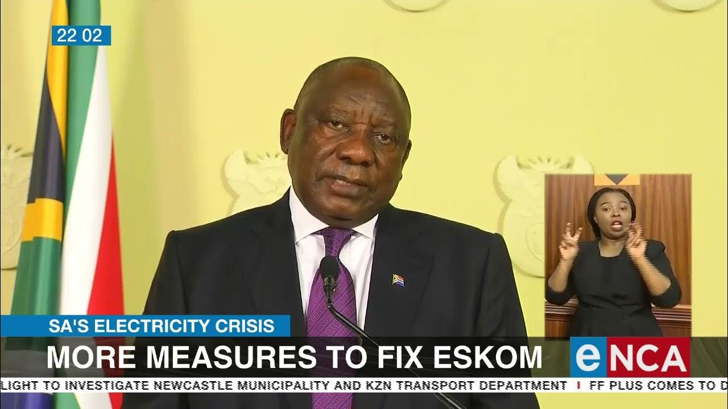
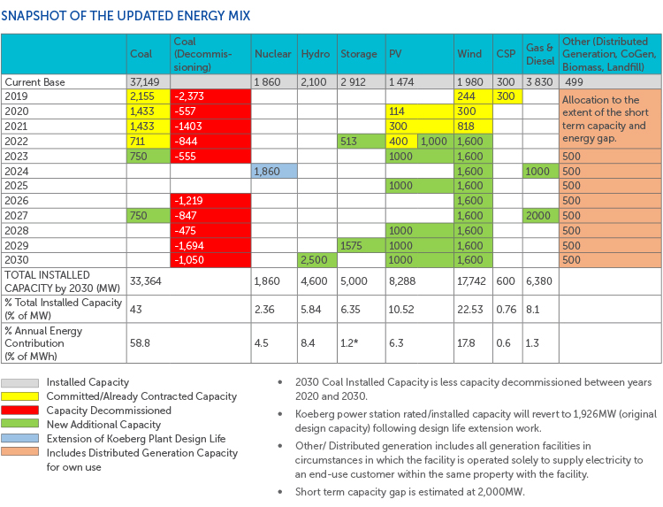

CONTEXT to Electricity Crisis
ESKOM
Power System Balancing ACT
LOADSHEDDING
CALL TO ACTION
Integrated Resource Plan 2019
DDMP + others
While load shedding continues to impact the country and the economy, we were able to contain the intensity below the levels that were anticipated in our winter outlook
2

Slide 3

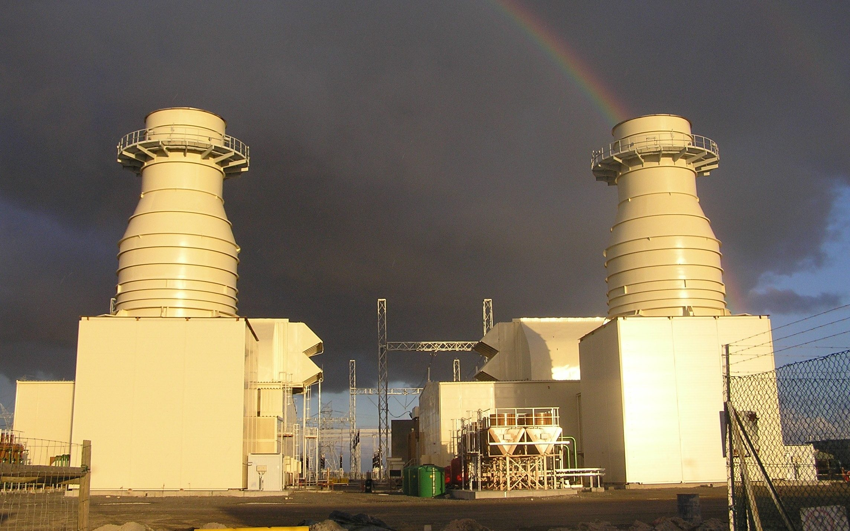
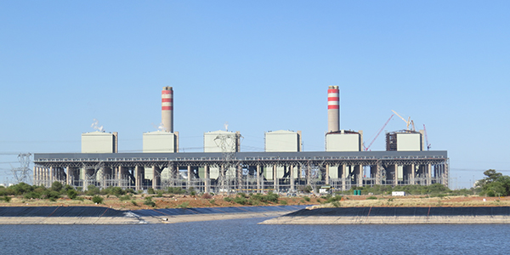
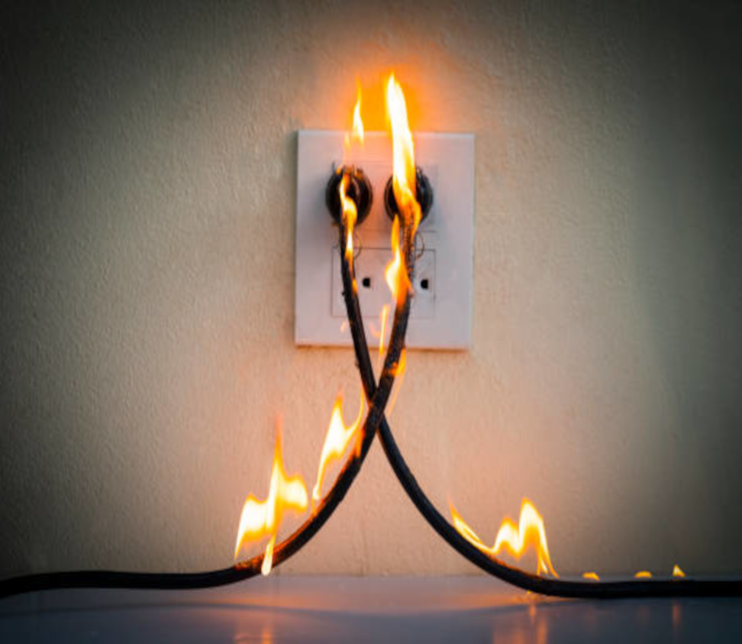

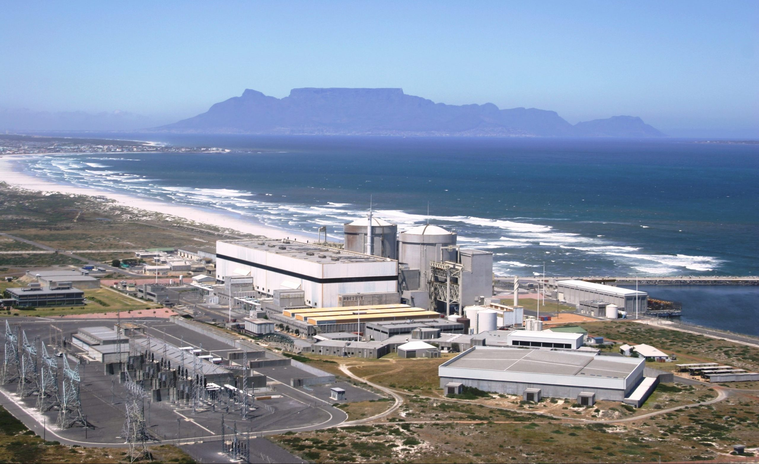

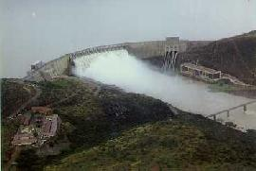



BALANCING ACT – DEMAND AND SUPPLY

Slide 4
We plan to return units on long term outage and execute major refurbishment projects to recover 8472 MW
Key insights
Due to the delays being experienced in replacing the steam generators at Koeberg U1, commercial operation forecast 3 November 2023 and Koeberg U2 Long Term Operation outage starts on 7 November 2023
Kusile Temp Stack erection started ahead of schedule. Kusile U1, 2, 3 & 5 will be synchronised to the grid by December 2023 and will provide 2880 MW
Tutuka RTS dates for Unit 1 & 2 by Jan 2024. Unit 3, 4 & 5 currently on load.
Medupi U4 will be operational in July 2024 with the second-hand stator
Kriel has completed replacement of cooling tower 4 and plan to complete the replacement by March 2024
Majuba has started re-bagging on unit 3 and plan to complete the re-bagging by March 2024
Tutuka has plan to complete the cooling tower replacement by October 2024
  Units on long term outage and major refurbishment projects
Majuba fabric filter plant re-bag and Kriel cooling tower replacement
1752 MW
Tutuka cooling tower replacement
720 MW
Koeberg
900 MW
Kusile
~ 2880 MW
Tutuka
~ 1500 MW
Medupi
~720 MW
Nov 2023
Oct / Dec 2023
Jan 2024
Mar 2024
July 2024
Oct 2024
Notes:
Kusile 720*4 = 2880, however actual output may be lower and gradually ramp up

Slide 5
Eskom is focussing on 6 key areas to deliver 250MW of demand reduction during the FY24 summer period
Overview of demand management initiatives
MW demand reduced
Focus area
Load Shifting/Clipping
Residential load management (RLM)
Energy Efficiency (EE)
Demand Response
Residential Mass roll out (EE)
Total FY24 summer target
1
2
3
4
5
6
MARKETING AND COMMUNICATION SUPPORT
6
Eskom is focusing on the above 6 areas to deliver 250MW of demand reduction during the FY24 summer period which will assist to alleviate pressure on the electricity system

Slide 6
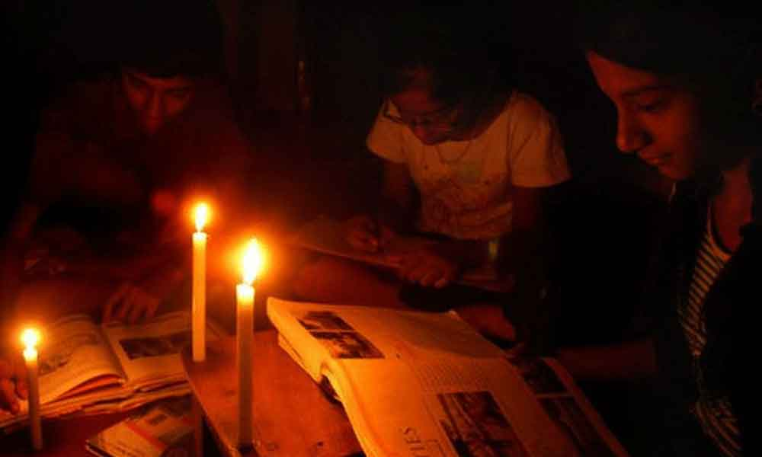
WE ARE THE SOLUTION TO LOADSHEDDDING
CALL TO ACTION
Concerns
+
Critical
Collaboration
+
Commit

Slide 7

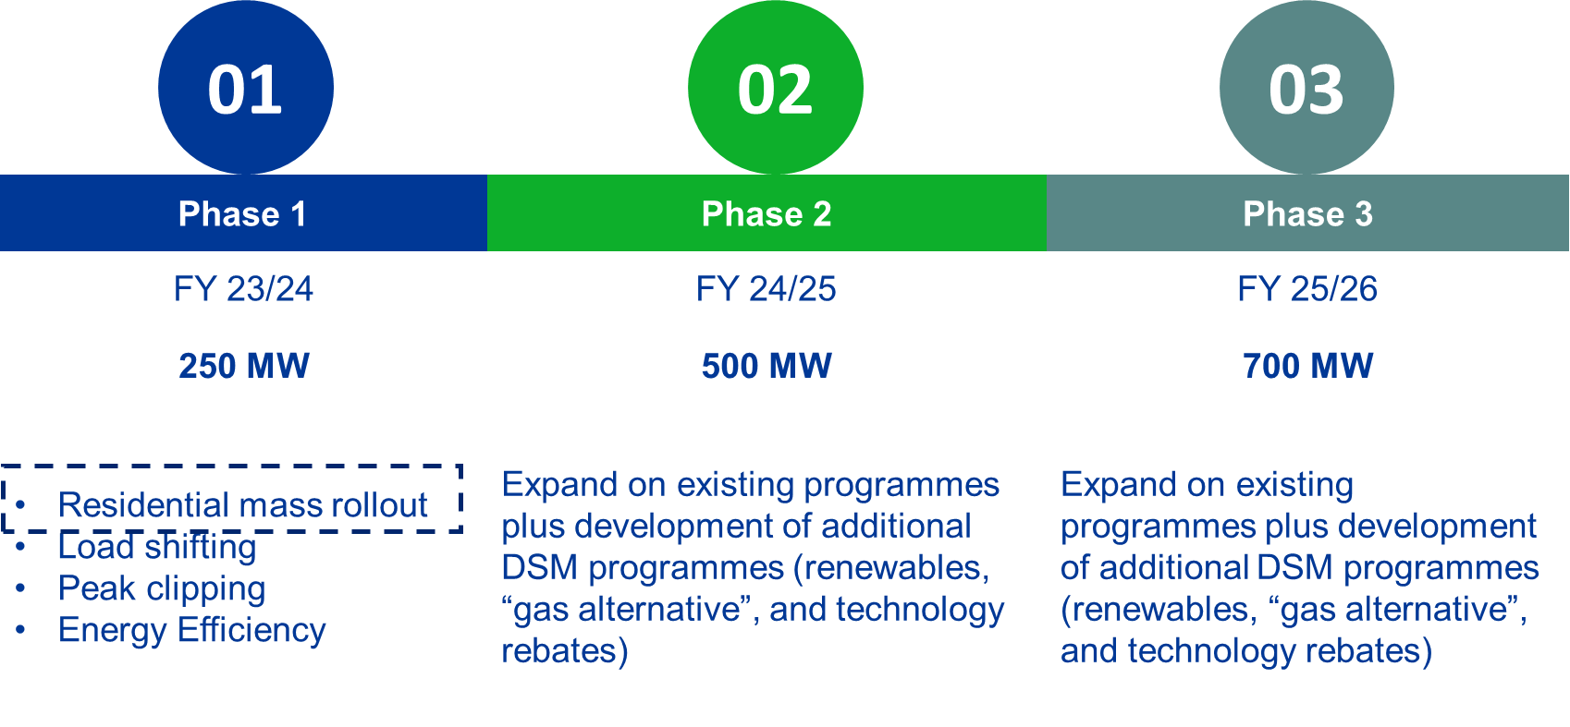
Distribution Demand Management Program (DDMP)
Once implemented, interventions are in place for the duration of the technology life, allowing savings ‘capacity’ to be built over time. Since inception, IDM (DSM) initiatives have effectively displaced the equivalent capacity of an average power station in SA, however due to financial limitations DSM programmes halted in 2018.
DSM rejuvenation was initiated from 2023, however funding remains a challenge.
1 Power Station
(6 x 600MW units)
Cumulative performance over time
Rejuvenation of DSM 296 MW FY23
No DSM activities [2019-2022}
Funding challenges
2005- 2023

Slide 8
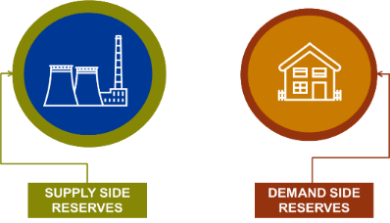
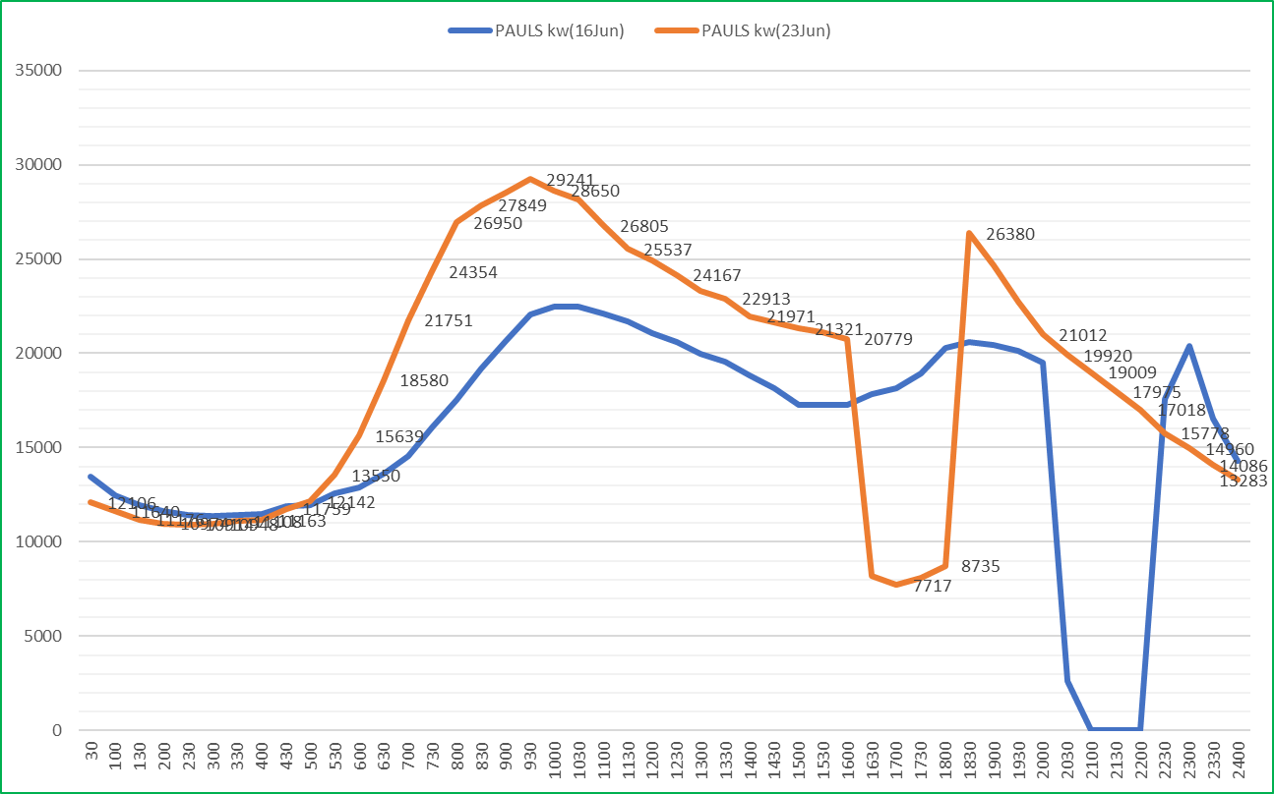
Framing the problem statement: Eskom levers to modify the Country DEMAND options to assisting in balancing Supply and Demand
What are the demand options available to alleviate supply constraint?
1
Country Problem Statement
The unavailability of generation capacity to meet customer demand leading to loadshedding
Aim: Optimize the Demand Management Options
How do we implement Loadshedding with minimal economic impact?
2
Aim: Maintain spirit and principles of the NRS048-9?
How do we communicate to public and stakeholders?
Distributors to explore new ways to support the supply and demand optimisation
3
GOAL
Aim: To provide transparency and support customers to achieve mutual benefit

Slide 9
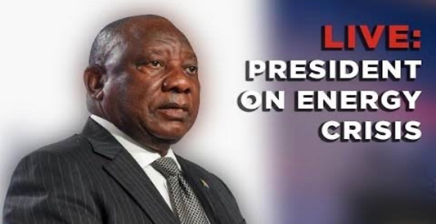
NECOM WORKSTREAM 5 –
DEMAND SIDE MAANAGEMENT
Structure (Chair)
Role
National Energy Crisis Committee
(President)
Overall political coordination of the response to the energy crisis consisting of ministers of; DMRE, DPE, DFFE, Finance, DTIC
Energy NatJoints
(Presidency DG and Secretary of Defence)
Technical oversight to focus on four key objectives:
Addressing the immediate electricity supply shortfall and ending load shedding
Improving the performance of Eskom’s existing fleet and positioning it for future sustainability
Implementing a coordinated plan by law enforcement agencies to address sabotage, theft and fraud at Eskom
Achieving medium and long-term energy security in the context of our climate commitments and growth
Additional measures to achieve long-term energy security and end load shedding for good:
  Fix Eskom and improving performance of existing fleet
  Accelerate private investment in generation capacity
  Accelerate procurement of new capacity from renewables, gas and battery storage
  Unleash businesses and households to invest in rooftop solar
  Transforming the electricity sector to achieve energy security
8 X workstreams
Plant Performance
Grid strengthening
New Generation Capacity
Demand Management
Safety and Security
Regulatory and Legal
Procurement and Financing
Data Analytics and Research
Communication
Delivery
Energy NATJOINTS has established multi-stakeholder workstreams to deliver outcomes outlined by the President
Short term interventions focused on bringing new generation capacity as quickly as possible, with longer-term actions to achieve energy security
Measures detailed in the Action Plan to assist in reducing the impact of Load Shedding and will serve as the implementation plan for each work stream
Cross cutting

Slide 10
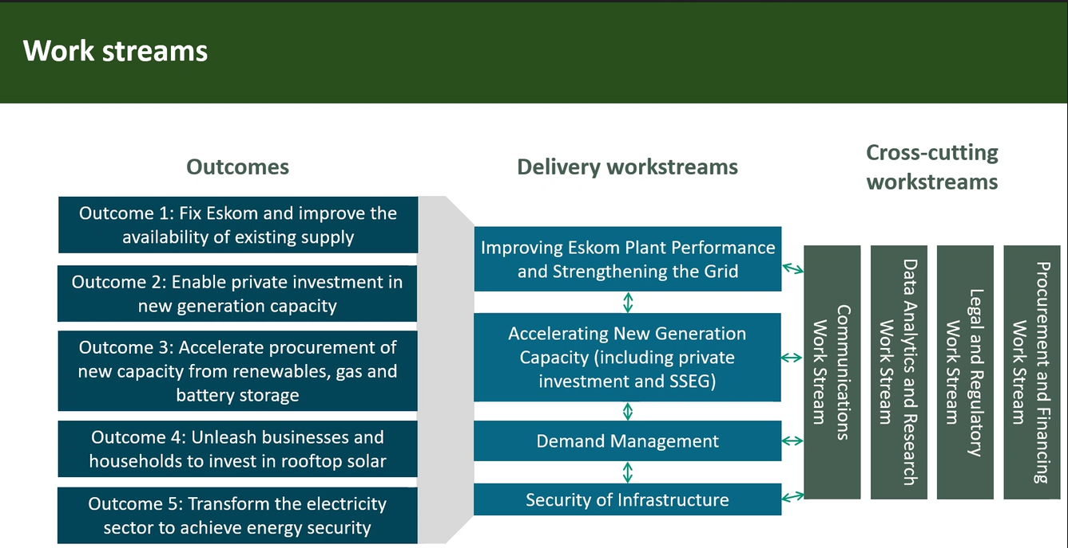
NECOM Structure

Slide 11
Eskom Product and Services
Let’s add
more Kilowatt-hours
to the Grid!
Your electricity trading and grid services partner

Slide 12

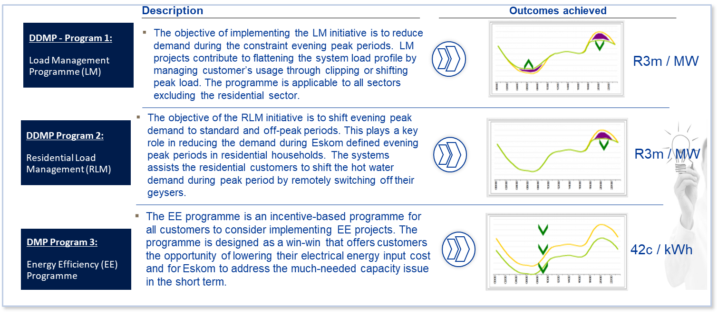
Distribution Demand Management Programme
The current DDMP follows a performance contracting approach. Awarded contracts are provided with an incentive (Rand/MW or Cents/kWh) for achieved demand and/or energy reduction during specified periods. Incentive rebates are paid quarterly (eight quarters) for the savings realised over a 24-month sustainability term.
PRODUCT 1
Distribution Demand
Management Program
More information: https://www.eskom.co.za/distribution/demand-management-programme/

Slide 13
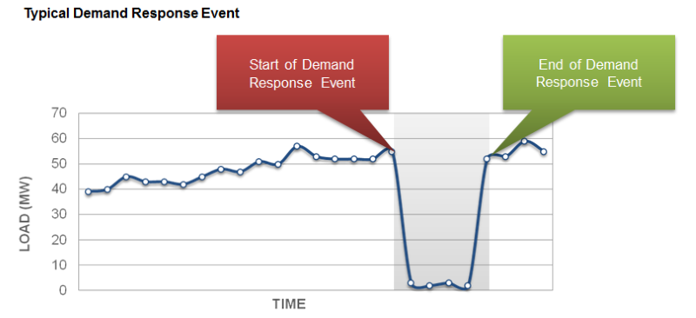
Demand Response
PRODUCT 2
Eskom is piloting a national demand response programme in the small commercial and residential sector in response to the electricity crisis facing South Africa at present.
The objective of the pilot is to test, among others, the appropriateness of technologies, market uptake, and the implementation and participation in this sector. The pilot will enable Eskom to evaluate projects on an ongoing basis up to 29 September 2023 or until the threshold of 50 MW has been reached, whichever comes first.
What is offered?
Qualifying aggregated load providers (ALPs) that meet the demand response criteria will be compensated to reduce aggregated electricity demand when dispatched via Eskom’s system operator.
Energy Rate = R 2500 / MWh (500 Hours or 2 events per day)
Demand Response
More information:
https://www.eskom.co.za/eskom-divisions/tx/demand-response/demand-reponse-pilot/
Notes:
Two purchase pricing options
Year-ahead time-of-use static adjusted annually by the average Eskom price increase
Dynamic day-ahead per hour reflecting marginal costs of generation per hour
Choice of price option locked in on 1 April for 12 months
Contract within Standard Offer allowed time-frame with an anticipated extension to 2028.
With/without a base-line
With or shortly anticipating license/registration to generate.
Traders with mandate from generation owners
Maximum purchase contract value with a minimum three-month review period

Slide 14
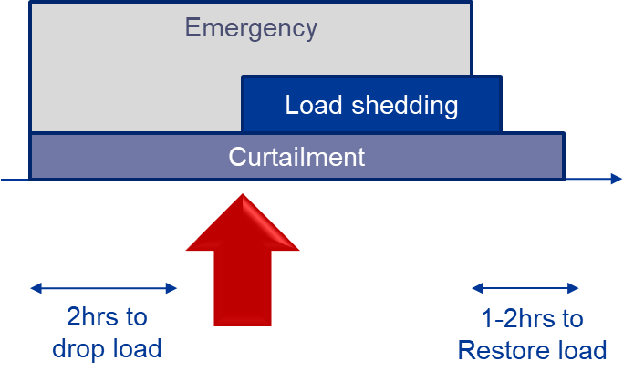
Load curtailment
PRODUCT 3
NRS 048-9 Emergency load reduction (70 % of feeder load)
  Load curtailment – load reduction obtained from customers who are able to reduce demand on instruction
National load reduction requirements (load shedding and curtailment) under a system emergency declared by the System Operator in the event of a national generation capacity constraint
Agreed notification period and for the duration instruction
Load shedding load has a 15-30 min response time + Curtailment has a 1-2hr response time
Critical loads are loads that are critical for maintaining the operational integrity of the power system, or for avoiding a cascading impact on public infrastructure
What is offered?
Exclusion on certain loadshedding stages.
Reduction % = Stage 4 → 20% reduction in normal demand profile
Load curtailment
More information:
NRS 048-9
Notes:
Two purchase pricing options
Year-ahead time-of-use static adjusted annually by the average Eskom price increase
Dynamic day-ahead per hour reflecting marginal costs of generation per hour
Choice of price option locked in on 1 April for 12 months
Contract within Standard Offer allowed time-frame with an anticipated extension to 2028.
With/without a base-line
With or shortly anticipating license/registration to generate.
Traders with mandate from generation owners
Maximum purchase contract value with a minimum three-month review period

Slide 15
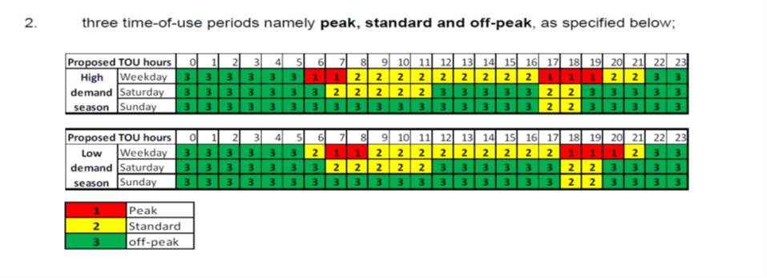
Eskom Distribution Standard Offer
1 April 2023 to 31 March 2024
Commercial energy rate (R/MWh), excluding VAT
 | High-demand season | Low-demand season
Peak | 3 638.90 | 1 510.14
Standard | 909.73 | 849.08
Off-peak | 606.48 | 606.48
PRODUCT 4
Illustrative ToU periods
Two purchase pricing options
  Year-ahead time-of-use static adjusted annually by the average Eskom price increase
  Dynamic day-ahead per hour reflecting marginal costs of generation per hour
NERSA allowed levels
  Based on the NERSA approved cost recovery for Eskom generation.
  Recovers the average cost of generation
Eskom purchase rate (R/MWh)
  High-demand: June to August
  Low-demand: Rest of year
  Contractual year is April to March
  ToU periods subject to Eskom Board decision at start of the year.
Standard Offer
More Information:
https://www.eskom.co.za/distribution/distribution-energy-trader/
Notes:
Two purchase pricing options
Year-ahead time-of-use static adjusted annually by the average Eskom price increase
Dynamic day-ahead per hour reflecting marginal costs of generation per hour
Choice of price option locked in on 1 April for 12 months
Contract within Standard Offer allowed time-frame with an anticipated extension to 2028.
With/without a base-line
With or shortly anticipating license/registration to generate.
Traders with mandate from generation owners
Maximum purchase contract value with a minimum three-month review period

Slide 16
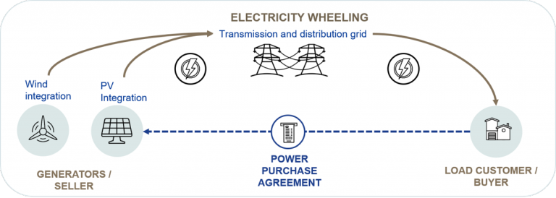
Wheeling
PRODUCT 5
Wheeling
Virtual Wheeling
Supports customer de-carbonization efforts
Promotes renewable energy
Provides additional kWh to the grid
Customers pay for use of the network
Customer can consume from Eskom and through a private bilateral PPA
More Information:
https://www.eskom.co.za/distribution/tariffs-and-charges/wheeling/
Notes:
A corporate entity or trader (the “buyer”) wants to buy energy from an independent power producer (IPP) to meet, for example, renewable energy targets.
This buyer is responsible for selling or transferring this energy to multiple offtakers, which may be connected to the Eskom grid or to a municipal grid, many of which could be connected at lower voltages.
The IPP is connected to the Eskom grid.
Energy will be delivered over the Eskom grid and now needs to be allocated to all the offtakers.
This allocation, unlike traditional wheeling, will not be done per individual offtaker’s account, but through a platform that would aggregate all the consumption of the offtakers and the generation by the IPP.
Each offtaker will pay its account in full, and no refund will be processed on individual accounts.
The refund will be provided to the buyer as a single value, and the buyer will be responsible for doing the allocation to each offtaker.
The refund is not per offtaker’s account and is not seen as a purchase or payment, but is a refund of an overpayment on each offtaker’s account, using the same formula as is done under traditional wheeling.
The transaction will be formalised through a virtual wheeling contract, which will be a new type of contract, not an electricity supply agreement, and the terms of which will be vetted by Legal, Finance, Tax, Pricing and any other parties identified in the process

Slide 17
CHALLENGE
+
Commitment
Be part of solution – “Every MW count”

Slide 18
In addition to demand reduction, Dx is also focussing on five other initiatives to relieve pressure on the electricity system
Challenges
Description
1
  Increase participation in 5 incentive schemes to manage supply and demand
  Energy Efficiency audits
  Reporting Energy efficiency milestones and targets to NECOM
Eskom Demand and Supply Products
2
Collaborate and partner of the establishment of Energy ambassadors' program
Share the Energy saving tips and cobranding – material available
Communication Campaign
  Participate in Solar Geyser and Heat Pump rebate
  A technology mass rollout is a programme where a single or multi-technologies are rolled out over a targeted area over defined time frame using various rollout methodologies and incentives to targeted customers.
3
Rebate scheme
4
  Young energy ambassadors
  Distribution of material – Teachers, learners and parents (Start at HOME)
  Collaborate and sponsorship of school's energy competition
Schools energy program
5
  South Africa has put in place regulations that require appliances sold in South Africa to meet Minimum Energy Performance Standards (MEPS).
  Significant energy savings, improve operational competitiveness and alleviate pressure on the country’s electricity supply
Minimum Energy Performance Standards

Slide 19

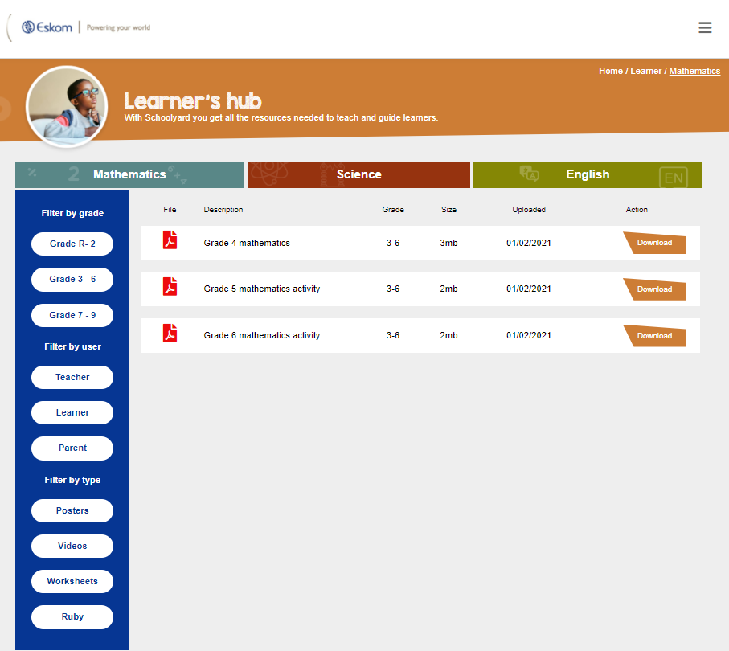
Website: Home - The Schoolyard (eskom.co.za)

Slide 20

https://www.rubybook.co.za/book-water.php

Slide 21


Slide 22


Website: https://www.stateofthenation.gov.za/takechargesa/about-necom

Slide 23

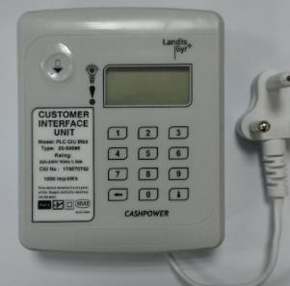
THANK YOU

